Slide 1

Progress Report
Name:- Rahul Diwan
Application No:- 97230001039
Project/Reporting Manager:- Mr. Keshav Raghuvanshi sir
Entity:- COE

Slide 2

Project Overview
Project Name:- eShiksha-LMS (Learning Management System)
Department:- Department of Science and Technology
Purpose:-
Provide training and self-learning courses to govt. department employees.
Will also track the learning activities of all employees.
A department can also provide a certificate to motivate the employees.

Slide 3
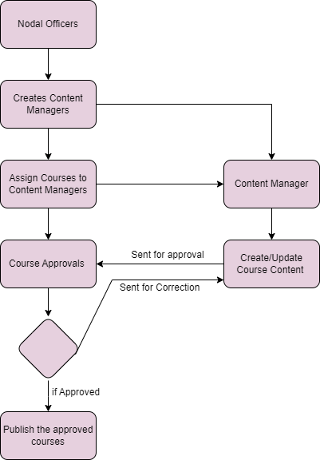
Approved
Project work and Flow

Slide 4
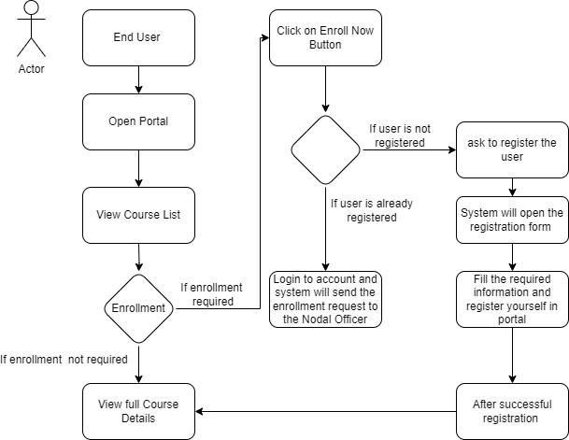
Registered
Working Module

Slide 5
My role and responsibility :-
Frontend / User End
User Registration and authentication Module with encryption and decryption.
Different roles for administrators, instructors and students with corresponding access privileges.
Contributed in UI/UX design of project.
Bug Fixing
User dashboard
Admin Dashboard –
Total available course department wise.
Total registered student/employes department wise.
Total registered students
Functional Bugs.
Logical Bugs

Slide 6
Thank you

